Slide 1
Replicating SURF: Summarizing App Reviews
Brad Bruesewitz

Slide 2
Introduction/Motivation
Pivoted from creating my own classification
Reproducing previous work and making suggestions and improvement recommendations seemed more useful
Personal interest in classification of app reviews

Slide 3
Refresher
Paper introduced SURF (Summarizer of User Review Feedback)
The aim of this tool/study was to:
Shorten the amount of time needed to analyze app reviews
Improve the developers’ understanding of user needs
Determine the perception of developers regarding the tool (do developers find the tool useful?)

Slide 4
Problem
Conflicting results in the paper
Hard to decern if the tool is useful or not
Paper gives few examples of SURF output, hard to form a strong opinion yourself solely by reading the paper

Slide 5
My Goal
Assess the usefulness of SURF based on the following questions (adapted from the paper’s research questions):
Does SURF save me time?
Are reviews correctly classified?
Does SURF help me better understand user needs?

Slide 6
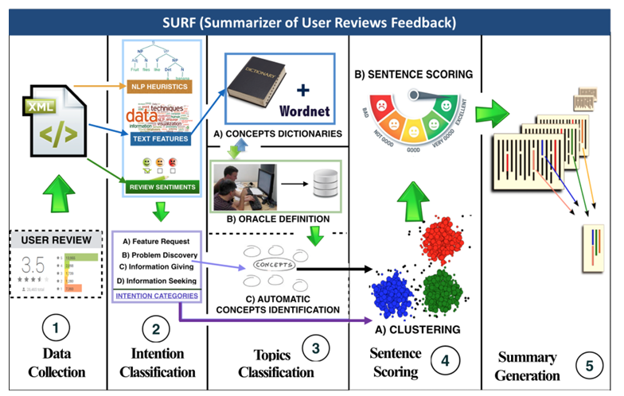
Implementation of SURF

Slide 7
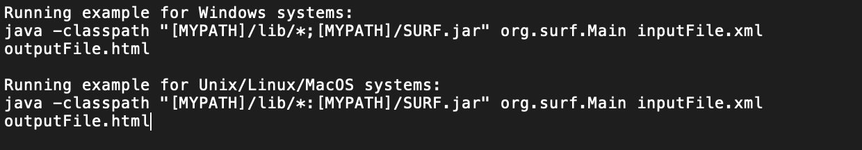
Replication Steps
Download replication package
Includes XML files, jar files, html output files, data from surveys
Make sure XML files are in the same directory as the jar files
Run the following in the command prompt/terminal:

Slide 8
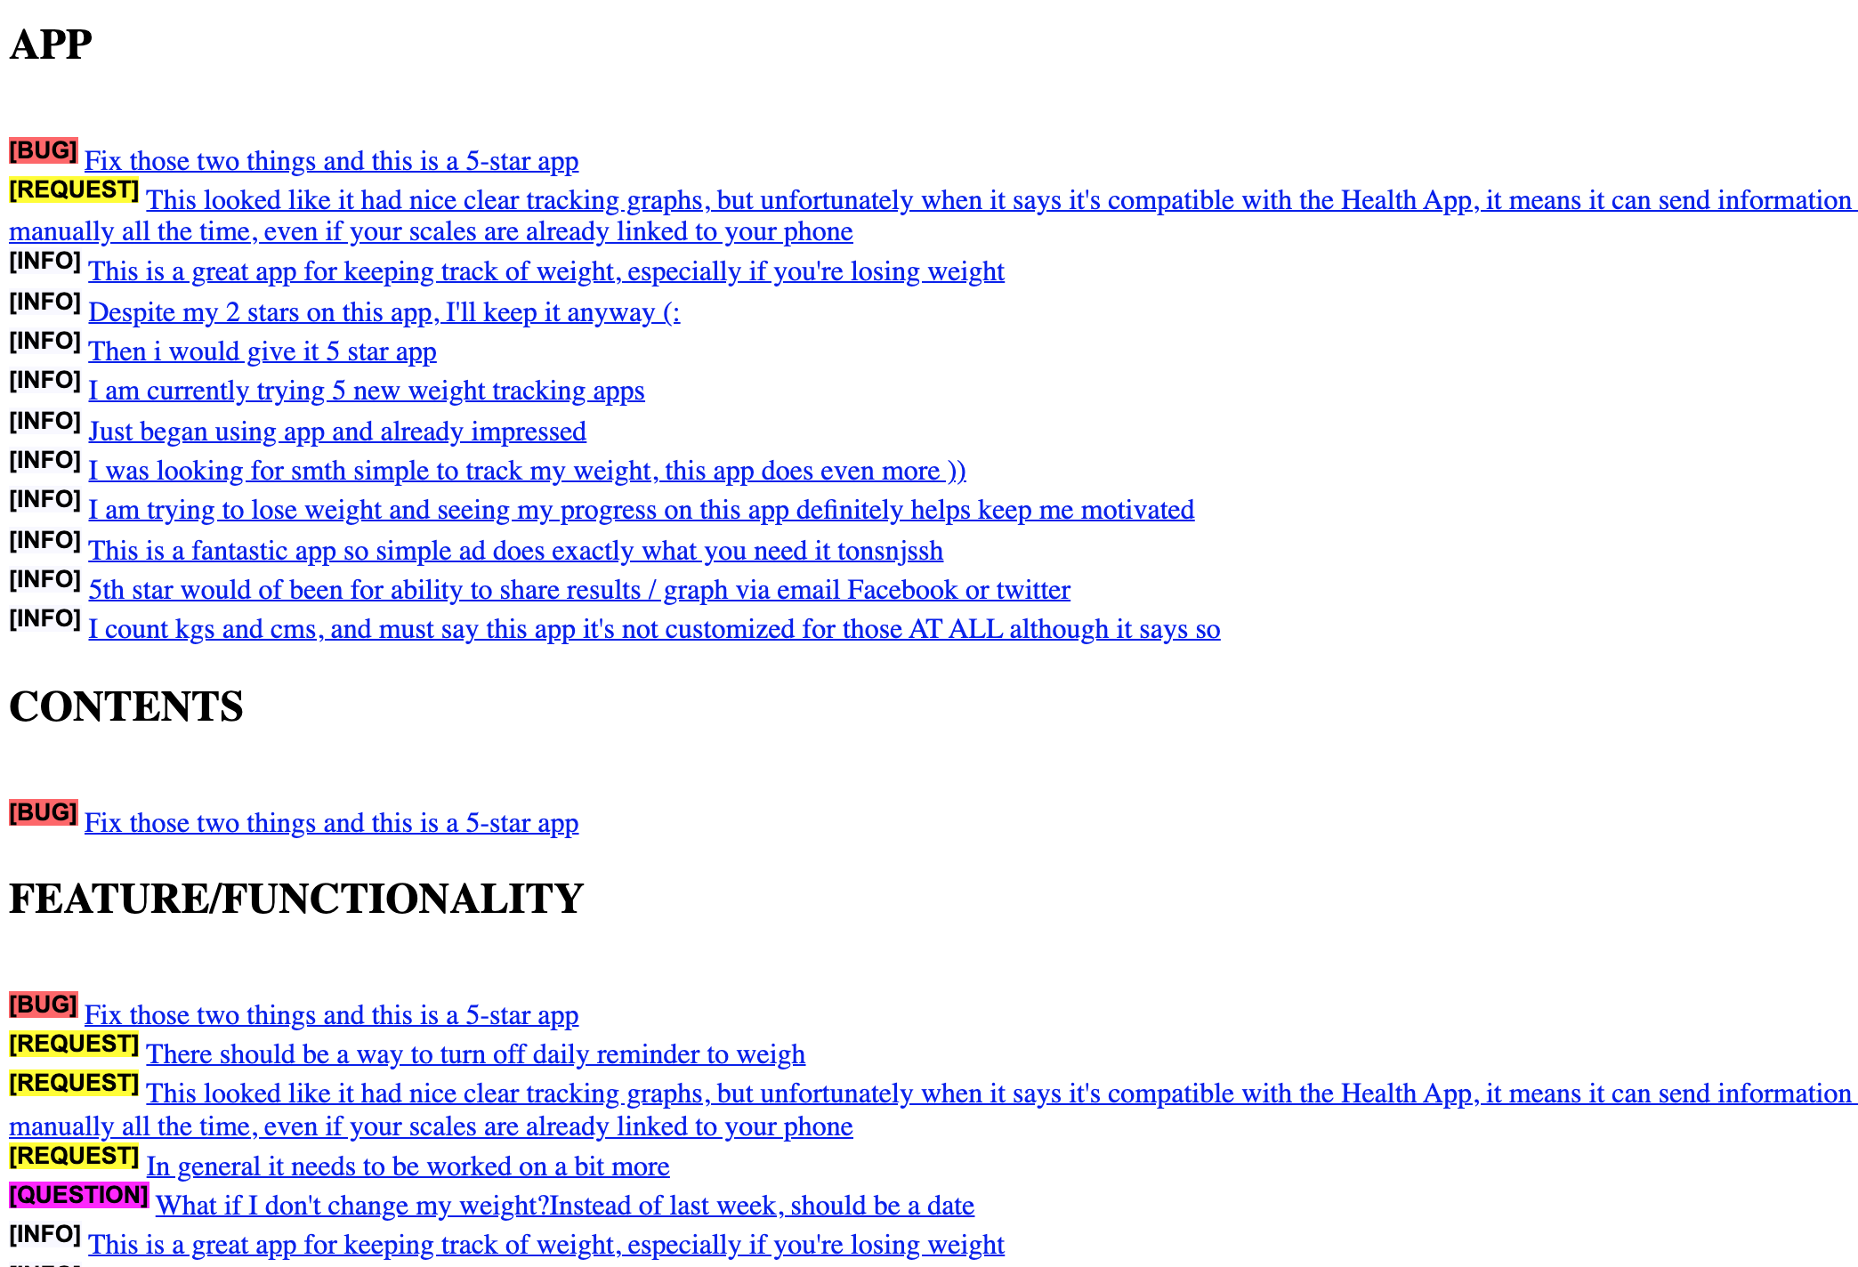
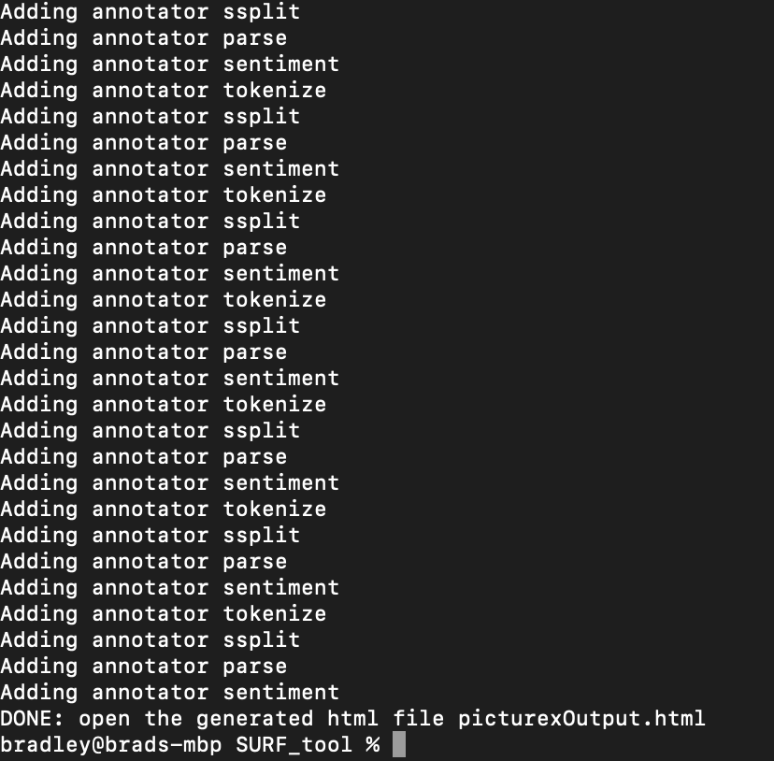
Replication Screenshots

Slide 9
Replication Steps (continued)
Ran all XML files and compared my output with the html output in the replication package
For each html output:
Verified correct classification based on my own thoughts (no ground truth given in replication package)
Compared differences in the original output versus my own output
Evaluated each summary based on my own perception of its usefulness

Slide 10
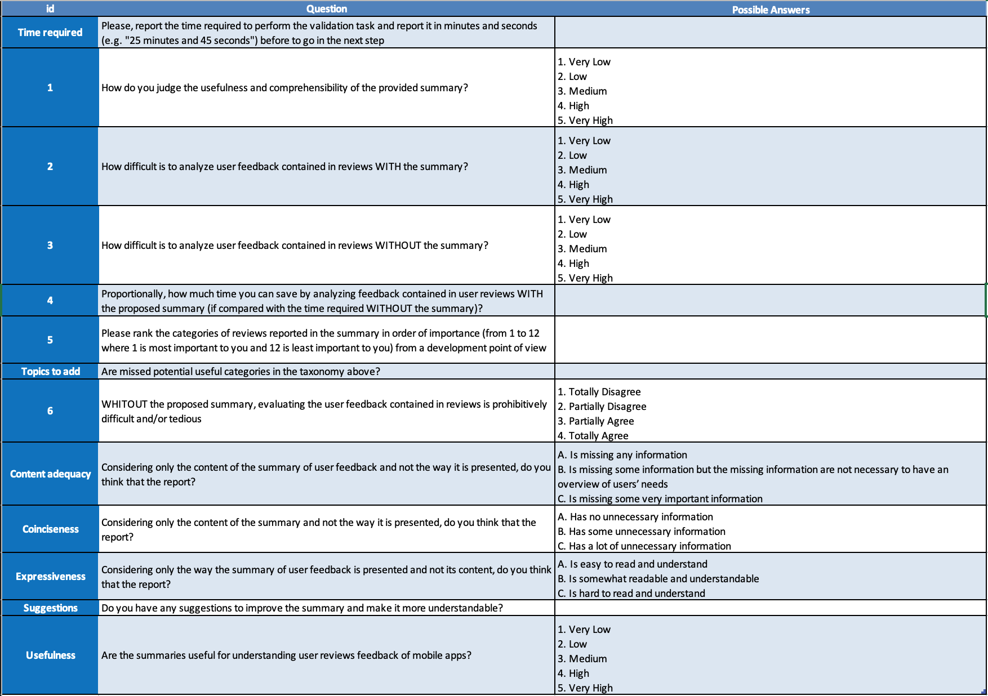

Slide 11
Does SURF save me time?
Hard question to answer
Time to run SURF doesn’t include preliminary time it would take to extract reviews into XML format
No baseline to compare to
Original study only asked users "to express their opinion on the speed-up introduced by the summary in analyzing the user feedback”
The data expressed in the research is purely subjective
Personal conclusion: it still took a lot of time to sift through the summaries, especially ones with lots of sentences

Slide 12
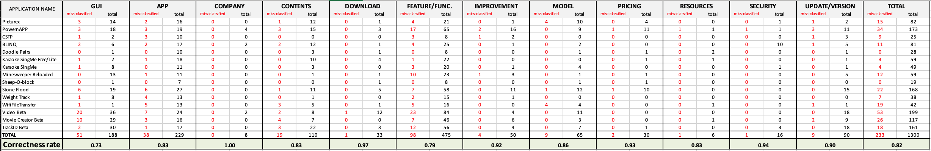
Are reviews correctly classified?
My correctness total was less than that of the experiment, dropping from 0.91 to 0.82.
0.82 is still fairly accurate, the paper does not define acceptable criteria for this number. In my opinion, it felt like there were a fair amount of incorrectly classified reviews.

Slide 13
Does SURF help me better understand user needs?
Five summaries still had over 100 sentences to sift through
Hard to understand what users were talking about
However, this original experiment used developers of these apps to read through reviews of their OWN apps, so obviously they understood their own app and likely had a better understanding of what users were referring to

Slide 14
Observations
Some subclassifications were inconsistent (sometimes the same sentence was a BUG in my run but classified as INFO in theirs)
Some sentences were duplicates and were classified in multiple categories
Even with preprocessing the summaries still seem to include plenty of sentences that give no useful information
Missing information about a “ground truth” for how to identify a correctly classified review sentence
Unclear how to create the time comparison to see if time is saved or not

Slide 15
Suggestions
Most of the sentences classified as “INFO” were not very helpful, eliminate this classification and focus on the other categories (“I am currently trying 5 new weight tracking apps”)
To avoid redundancy, shorten the list of Review Topics (they had a list of 12, probably only need 3-5)
Redesign the study
Design a ”ground truth” for accuracy validation purposes
Develop a way to get a true comparison of time saved (baseline based on number of sentences eliminated, time to read each sentence)

Slide 16
Threats to Validity
I am running a prototype version of SURF (unsure if this is the same version the researchers were using)
No ground truth to compare my results to (verification step is purely subjective)
Not given information about how they drew their time comparison, unable to replicate this research and give an evaluation

